Slide 1
CIS117 Week 1
Linux Basics

Slide 2
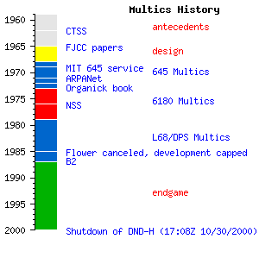
In the beginning
Multics (failed project)
Bell labs Thompson and Ritchie (Kernighan)
Evolution
AT&T and Berkeley
*nix
BSD and Macs
http://enki2.tumblr.com/post/109340473774/multics-history

Slide 3

Linus Torvalds
Principal developer of the Linux kernel
Personal mascot of Tux now adopted as mascot of Linux
“Open source is the only right way to do software”
-Linus Torvalds
https://www.zazzle.com/linux_tux_penguin_pirate_sticker_black_ubuntu_etc-217400779153032358

Slide 4
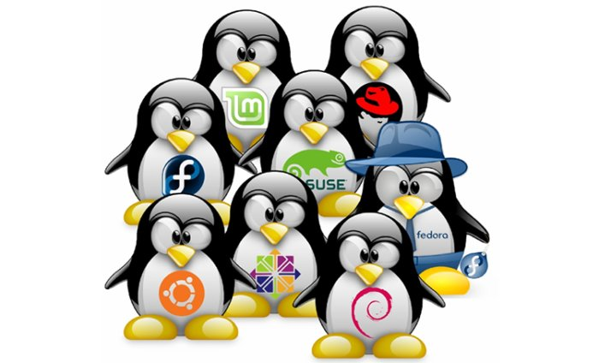
Common usage
Servers
Command line
GUIs
https://www.infoworld.com/article/3204592/linux/get-started-with-the-windows-subsystem-for-linux.html

Slide 5
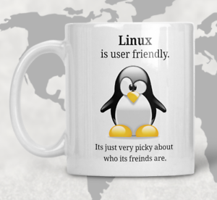
Advantages and disadvantages
Pros
Security
Multi-user
Maintenance
Cons
General use
Software availability
Unix is very user friendly. Its just picky about who its friends are.

Slide 6
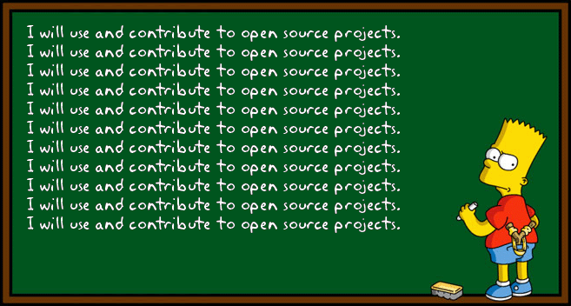
Open source software
Ethos
Availability
Community
https://blog.kentcdodds.com/how-getting-into-open-source-has-been-awesome-for-me-8480cd756a80

